Slide 1
Digital Search Structures

Slide 2
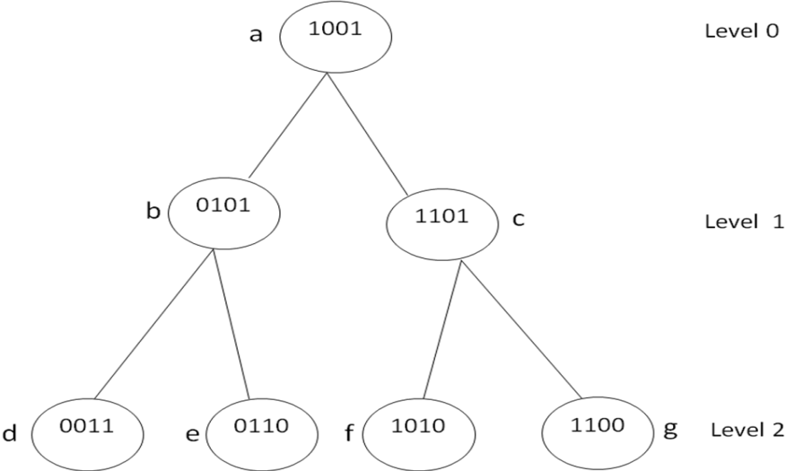
INTRODUCTION
A Digital Search Tree (DST) is a binary tree, where each node contains one unique element.
The element assigned to node is in binary representation.
The bits in the binary representation of a key are numbered from left to right.
For example in the binary representation 1000, bit one is 1, and bits two, three and four are 0.
All the keys in the left sub tree of a node at level i have bit i equal to zero whereas the nodes in the right sub tree at this level have bit i = 1.
The nodes in the left sub tree of the tree starts with bit 0 and the nodes in the right sub tree starts with bit 1.

Slide 3
Operations on Digital Search Trees
Similar to the Binary Search Tree (BST) operations, the Digital Search Tree also has three operations which could be performed on it.
Insertion
Searching
Deletion.

Slide 4
Insertion
For performing the operation of insertion, the first key inserted into the DST is considered as the root node.
The consecutive keys to be inserted are compared with the root node.
If the first bit of the key is 0 (key starts with bit 0) then the key is inserted as a left child at Level 1 and if the key starts with bit ‘1’ then the key is inserted as a right child at Level 1.
If already a node exists at this level 1, the next bit is considered to decide the position of the key at next level.
The process is repeated until all the keys are inserted into the digital search tree.

Slide 5
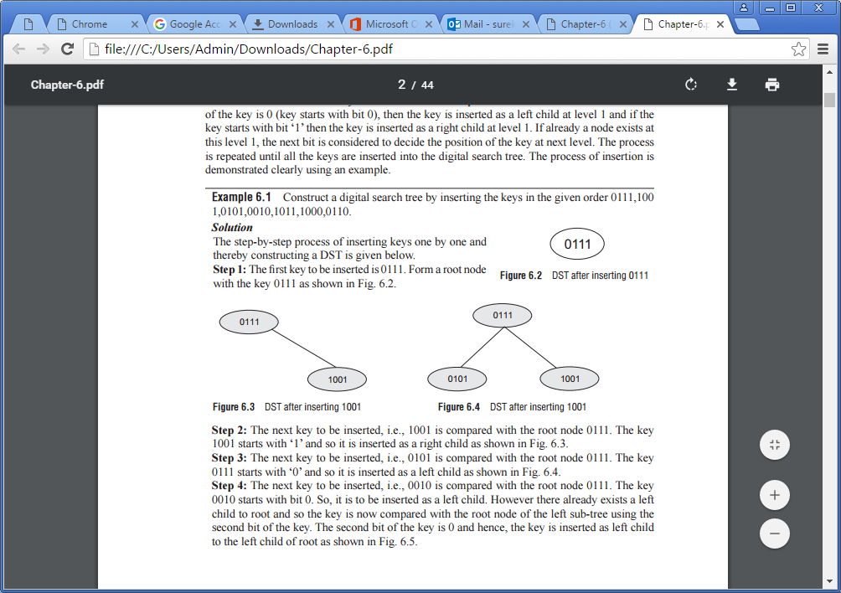
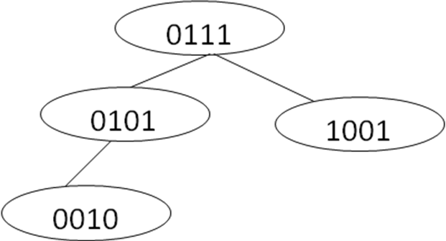
Insertion
Example : Construct a Digital Search Tree by inserting the keys in the given order 0111,1001,0101,0010,1011,1000,0110
Step 1: insert 0111 Step 2:insert 1001
Step 3: insert 0101 Step 4: insert 0010

Slide 6
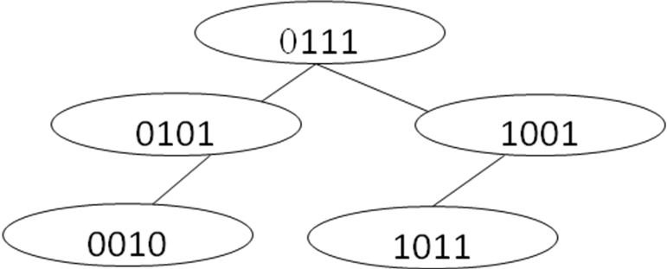
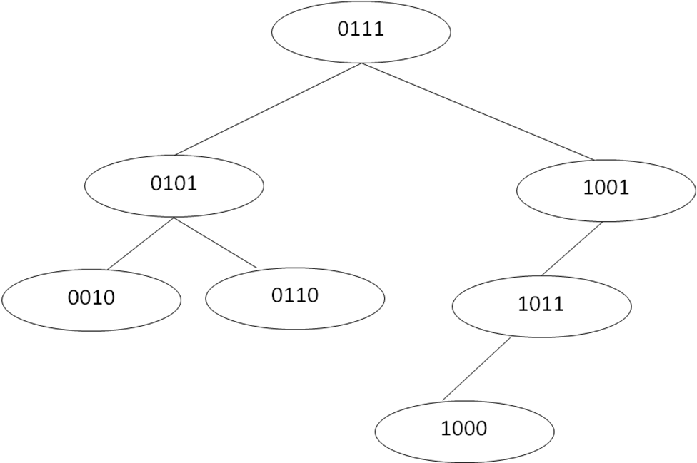
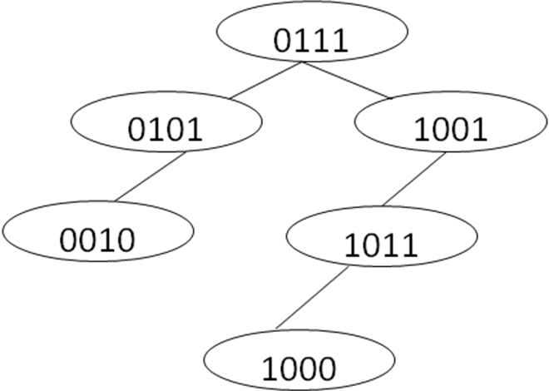
Step 5: insert 1011 Step 7:insert 0110
Step 6: insert 1000

Slide 7
Algorithm for insertion in a DST

Slide 9
Searching
The process of searching for an element in a digital search tree is similar to insertion into a digital search tree.
The process of searching for a key in a Digital Search Tree starts at the root node.
If the key is same as the root node value, the search stops as the element is found in the tree.
If it is not same, the first bit of the key is checked.
If it is 0, the left child of the root is checked and if it is 1, the right child of the root is checked.
The process continues till the leaf node is processed.
Finally, the algorithm returns “Found” if the element is found or else returns “Not Found”.

Slide 10
Algorithm for searching an element in a DST

Slide 12
Example: Consider the DST shown. Search for the element 1010 in the tree.

Slide 13
Solution: Let the tree pointer t point to root node of Fig. 7.10 and the search key is 1010. The step-by-step process for searching the element is given below.
Step 1: Check if t = = NULL
As t ! = NULL, goto Step 2
Step 2: Check if t -> value = = Key
As t->value of 0111 != key value of 1010, goto Step 3
Step 3: Consider two variables i and temp; where, i is an integer variable and temp is a temporary tree pointer.
Let i = 1 and temp = t
Step 4:
Iteration 1: Check if key[1] = =0. As the key value is 1010, key[1] !=0. In the “else” part check if temp->right! = NULL. Execute temp= temp->right. Therefore, temp is now pointing to 1001. As temp->value != key, goto else part and execute i++. Now, i = 2.
Repeat Step 4
Iteration 2: Check if key[2] = =0. As the key value is 1010, key[2] = =0. In the “if” part, check if temp-> left != NULL. Execute temp = temp ->left. Therefore, temp is now pointing to 1011. As temp->value != key, goto else part and execute i++. Now, i = 3.
Repeat Step 4
Iteration 3: Check if key[3] = =0. As the key value is 1010, key[3] = =1. In the “else” part check if temp-> right != NULL. Execute temp = temp ->right. Therefore, temp is now pointing to 1010. As temp->value = = key, write “Element Found” and Exit.

Slide 14
Deletion
Deleting an element from DST replaces the node with any leaf node in either of the nodes subtrees. Therefore deletion can be processed as two cases.
Case 1: The element to be deleted is a Leaf node.
Case 2: The element to be deleted has one or two children.

Slide 15
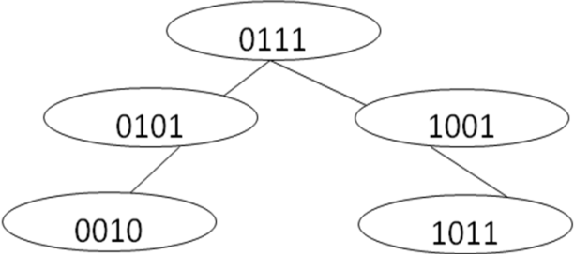
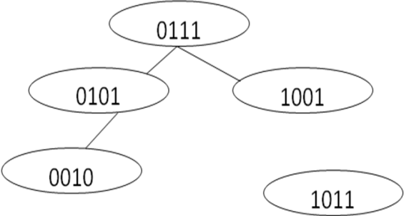
Case 1:
As the element to be removed is the leaf node, it can be deleted by just removing the link from its parent. The same process is followed even though the leaf node is either a left node or a right node.
Example: Consider the DST shown and delete 1011
After deleting 1011 from the DST

Slide 16
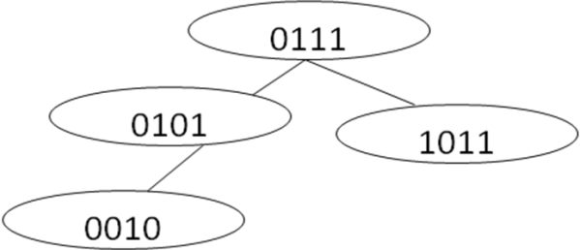
Case 2:
When the node to be deleted contains one or two child nodes, then the deletion can be performed by replacing the deleted node with any leaf node in either of the subtrees.
Example : Consider the DST shown and delete 1001
Note: 1001 has one child
The element 1001 is in the node which has one right child. This node can be removed by just replacing the deleted node 1001 with the child node 1011
After deleting 1001 from the DST

Slide 17
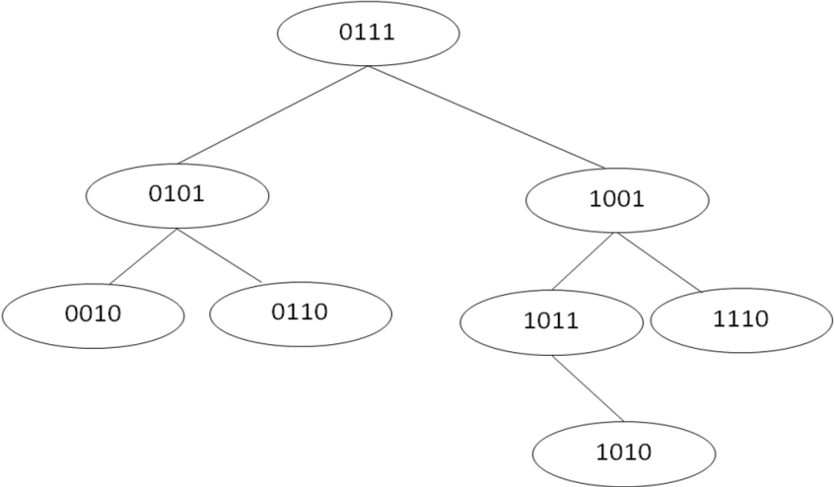
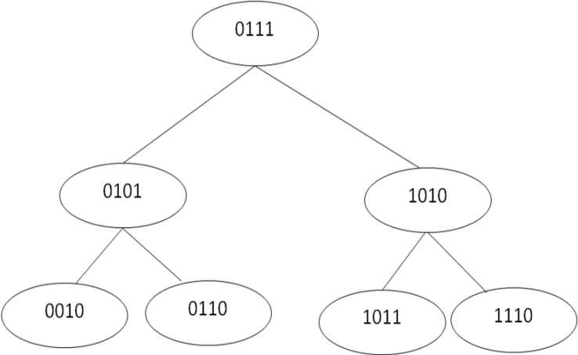
Example : Consider the DST shown and delete 1001
Note: 1001 has two children
After deleting 1001 from the DST
The element 1001 can be replaced with any leaf node from its sub-trees. From the Fig., it can be observed that 1001 can be replaced with either 1010 or 1110. Selecting 1010 to replace, the DST after deleting the element 1001 is shown.

Slide 18
Algorithm for Deletion
delete_dst(tree *t, key)
Step 1: IF t = = Null
Write “Tree is NULL, deletion not possible”
[END OF IF]
Go to Step 4
Step 2: Use the “dst_search(t, key)” algorithm and find the position of the node to
be deleted. Let the node to be deleted is represented as “temp” and its parent is
represented as “previous”.
Step 3: IF temp ->left = = NULL && temp ->right = = NULL
IF previous -> left = = temp
SET previous ->left = NULL
FREE temp
ELSE
SET previous ->right = NULL
FREE temp
[END of IF]
ELSE IF temp->left ! = NULL
Replace temp->value with any leaf node value of left sub tree
ELSE
Replace temp->value with any leaf node value of right sub tree
[END of IF]
Step 4: EXIT

